Slide 1


















Path to Clean Air in Sri Lanka:
Challenges & Solutions
Existing Challenges and Support Needed from Regional Stakeholders
Presenter: Akila Jayasundara (Environmental Officer) Central Environmental Authority, Sri Lanka
Date: 2025-11-25
Event: CLEAN AIR WEEK 2025
Get the final presentation or printable slides by clicking on this link, or scanning the QR

Slide 2



Central Environmental Authority (CEA) Sri Lanka
Government
Ministry of Environment
Central Environmental Authority (CEA)
About
Central Environmental Authority (CEA) was established on 12th August 1981, under the provision of the National Environmental Act No:47 of 1980. The Ministry of Environment which was established in December 2001 has the overall responsibility in the affairs of the CEA with the objective of integrating environmental considerations into the development process of the country. The CEA was given wider regulatory powers under the National Environment (Amendment ) Acts No:56 of 1988 and No:53 of 2000.
https://cea.lk/web/en/about-us

Slide 3
Overall Situation of Air Quality in Sri Lanka
Air quality is regulated through the Environmental Act, along with relevant Regulations, Standards, and Guidelines.
Air quality monitoring is carried out by both Government and Non-Governmental Organizations.
Air Quality Levels:
Generally, meet national standards (WHO IT 2, For PM), with occasional exceedances.
Usually do not meet WHO Air Quality Guideline levels.
☺️ ^{Satisfactory}
😑 ^{Less coverage}
☺️ Satisfactory
😓 Need to improve

Slide 4
Key Drivers of Air Pollution in Sri Lanka
Local Sources
Vehicular
Industrial
Domestic
Transboundary Pollution
~ Contribution of Local Pollution Sources
20% Domestic Emissions
20% Industrial Emissions
60% Vehicular Emissions

Slide 5
Key Actions or Initiatives: Control & Manage
Local Sources
Vehicular ➤ Mobile / Vehicle Emission, Fuel & Importation Standards & Regulations
Industrial ➤ Stationary & Fugitive Sources Emission Standards & Regulations
Domestic ➤ Regulation to Control Open Burning, Indoor Air Quality Guideline
Transboundary ➤ Contingency Response Action Plan for Deterioration of Air Quality in Sri Lanka
Common ➤ Air Quality Index for Sri Lanka (AQI-SL)
➤ Contingency Response Action Plan for Deterioration of Air Quality in Sri Lanka
➤ Contingency Response Action Plan for Deterioration of Air Quality in Sri Lanka
➤ Air Quality Index for Sri Lanka (AQI-SL)
➤ Air Quality Index for Sri Lanka (AQI-SL)

Slide 6
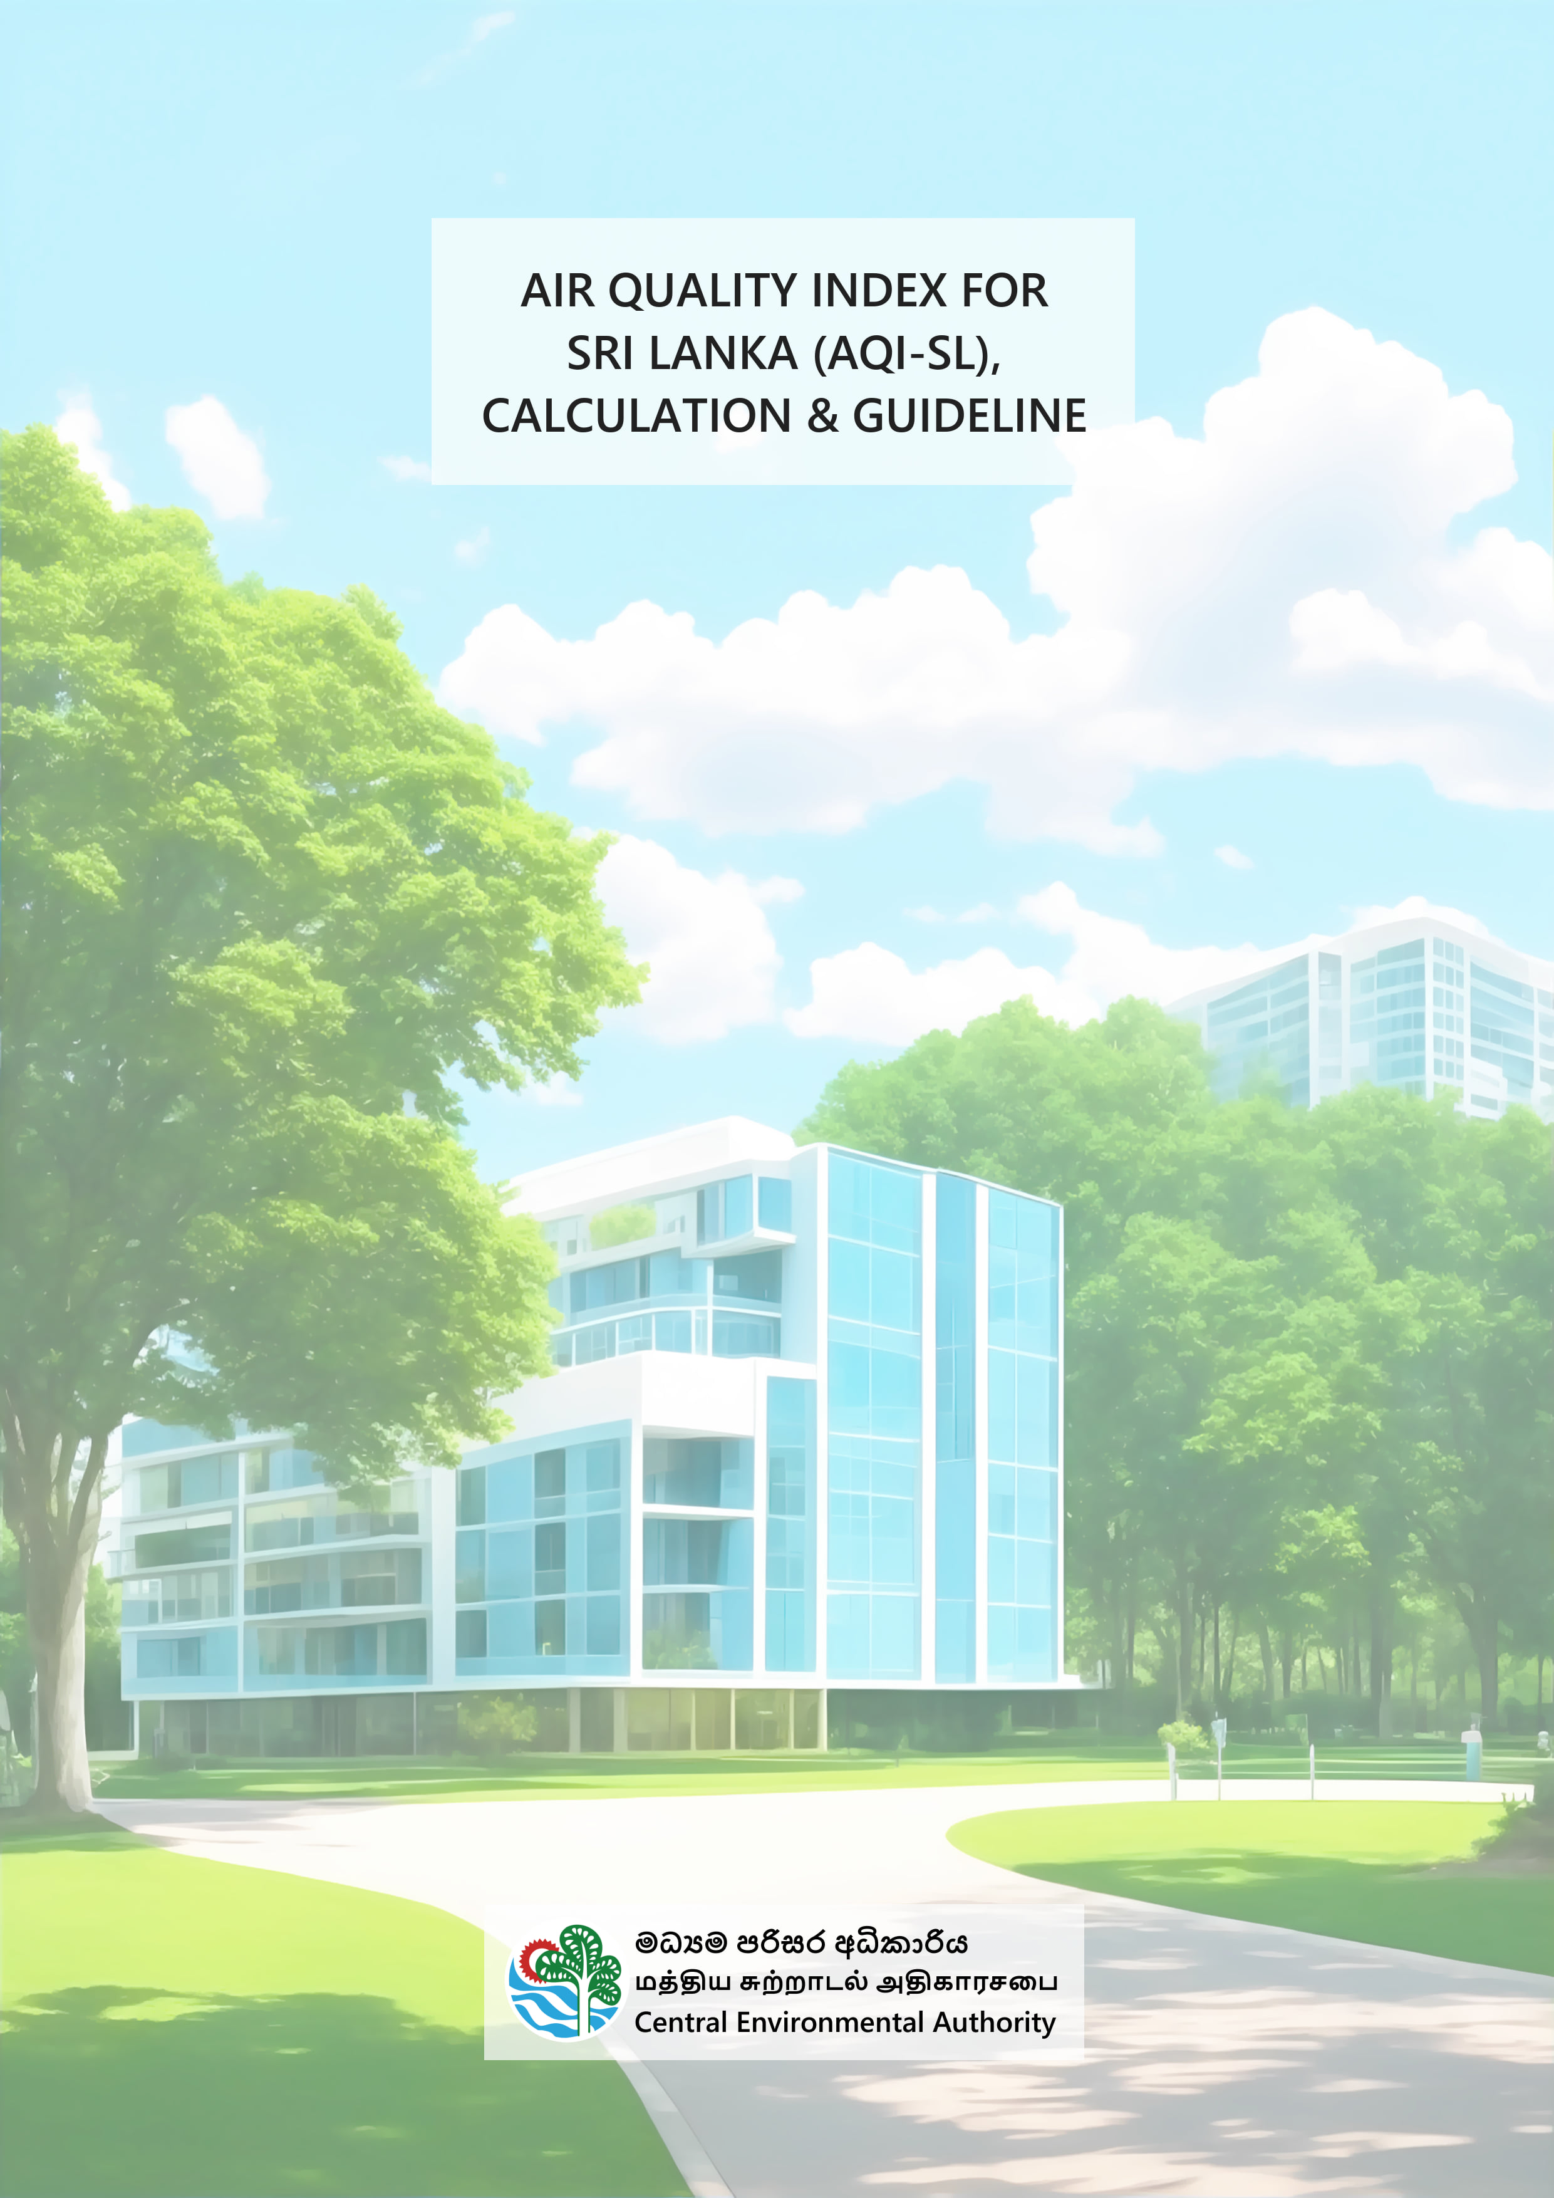
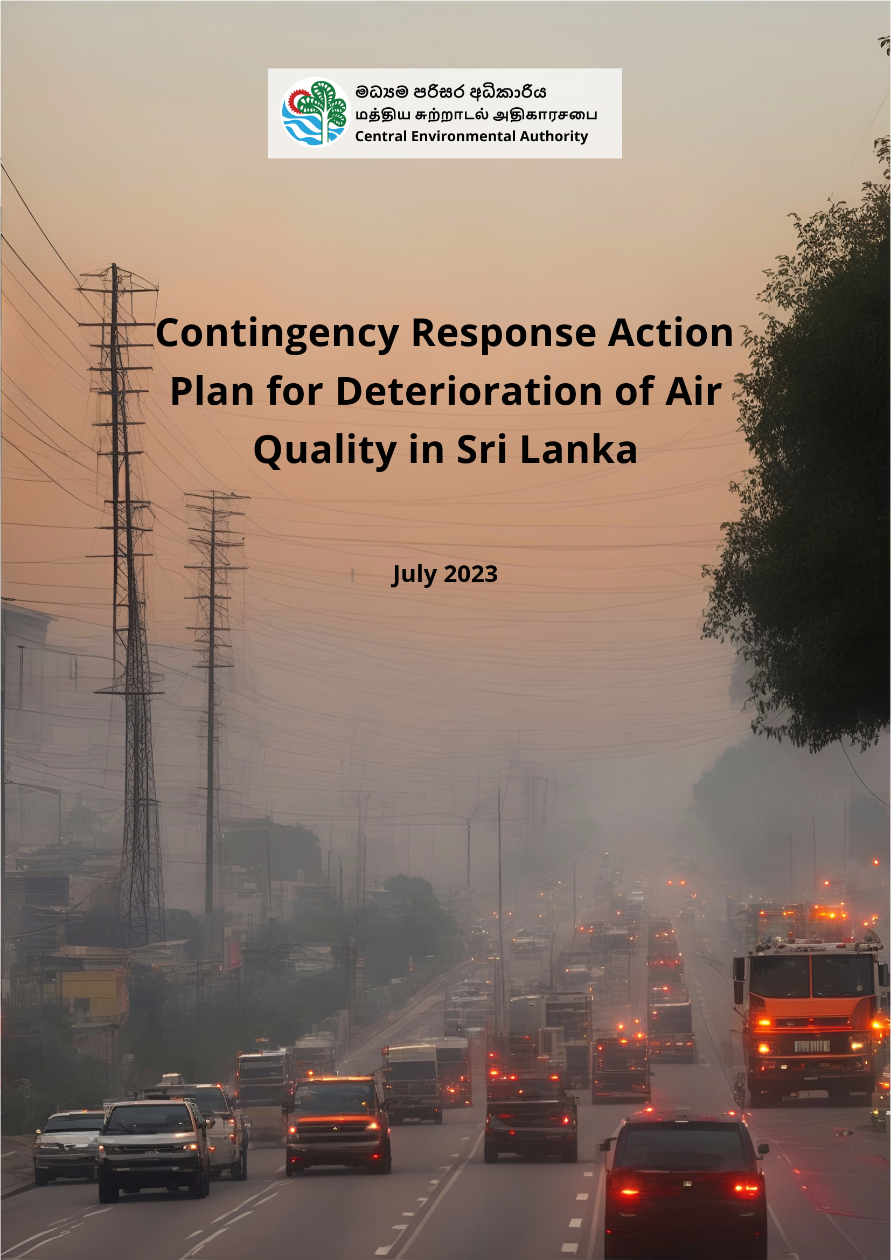

AQI-SL
CRAP-DAQ-SL
Green
Yellow
Orange
Red
Purple
Maroon
Alert
Warning
Emergency

Slide 7
Key Actions or Initiatives: Joint Actions
Local Joint Actions
AirMAC: Air Resource Management Centre
Clean Air Action Plan
VET (Vehicular Emission Test) Trust Fund
NEAP: National Environmental Action Plan, 2022–2030
Haritha Lanka Programme – Mission 1 “Clean Air – Everywhere”
National Air Quality Network, Sri Lanka
more…
International Joint Actions
UNEP: United Nations Environment Programme
ESCAP: United Nations Economic and Social Commission for Asia and the Pacific
AIT: Asian Institute of Technology
SACEP: South Asia Co-operative Environment Programme
CSE: Centre for Science and Environment (India)
AFD: Agence Française de Développement
Airparif: France
WHO (World Health Organization)
JICA: Japan International Cooperation Agency
JRDC: China-Sri Lanka Joint Research & Demonstration Center
RCEES / UCAS / CAS / HKEPD
more…

Slide 8
Challenges or Needs
• Limited monitoring coverage nationwide • No comprehensive emission inventory • Indoor air quality still under-addressed • Insufficient industrial pollution control technologies • High pollution episodes • Lack of modelling and forecasting capability • Financial problems / funding constraints • Lack of human resources
Limited Monitoring
Indoor Air Quality
High Pollution Episodes
Financial State
Monitoring coverage is insufficient across the nation.
Indoor air quality remains an under- addressed area.
Managing and responding to seasonal episodes of high air pollution.
Financial constraints and funding limitations.
Emission Inventory
Limited Technology
Modelling
Human Resources
A comprehensive inventory of emissions is currently unavailable.
Pollution control technologies are inadequate.
Lack of air quality modelling and forecasting.
A shortage of human resources poses a significant challenge.

Slide 9
Prioritized
Challenges or Needs
• Limited monitoring coverage nationwide • No comprehensive emission inventory • Indoor air quality still under-addressed • Insufficient industrial pollution control technologies • High pollution episodes • Lack of modelling and forecasting capability • Financial problems / funding constraints • Lack of human resources

Slide 10
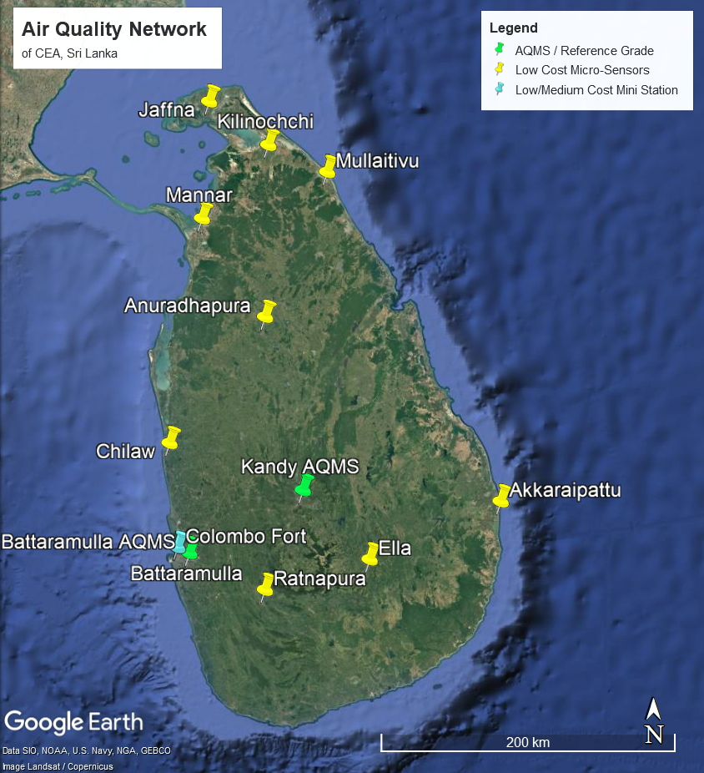
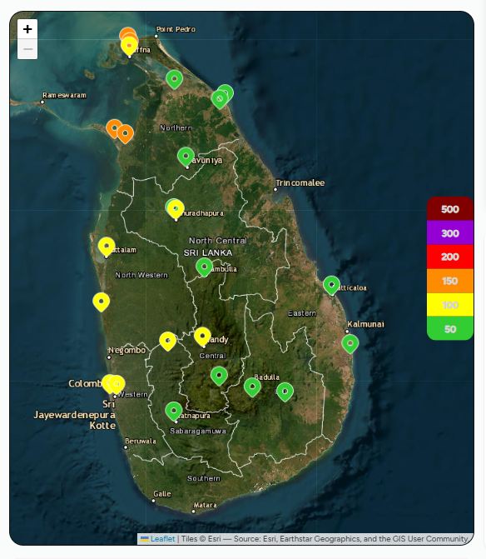
Limited Monitoring Coverage
CEA, Sri Lanka
Air Quality Network
The National Air Quality Network, Sri Lanka, currently includes:
2 Regulatory Reference-Grade Monitoring Stations
Supplementary Low-Cost Microsensors
Microsensors are operated by Central Environmental Authority (CEA) and National Building Research Organisation (NBRO).
CEA: 10 microsensors donated by UNEP (IQAir), and a mini station donated by AFD (Ellona)
NBRO: Network of 30+ sensors
⚠️ Note: Due to power or internet interruptions, some sensors may not appear on the live map. The screenshot of the live data map shows only devices with recent data.
Additional Data Sources
🌐 Other public/private institutions and government-related institutes also contribute air quality measurements. (FECT, CleanCo, US-Embassy, etc)
📊 Some universities and research organizations, such as University of Peradeniya, run multi-country projects using low-cost sensors (TSI) to study particulate matter with the collaboration of Duke University, USA.
Data from such research projects is primarily used for research rather than public reporting.
A Screenshot of the Live Data Map of The National Air Quality Network, Sri Lanka
A Screenshot of the Live Data Map of The National Air Quality Network, Sri Lanka

Slide 11
High Pollution Episodes
High Pollution Episodes usually occurs during the north-east monsoon periods, in between October and March (mostly in Nov-Dec-Jan-Feb). Usually, the whole country affects.
Date | S-A | S-B | S-C | S-D | S-E | S-F | S-G | S-H | S-I | S-J | S-K | S-L | S-M | S-N | S-O
2025-02-01 | 36 | 41 | 41 | 29 | 151 | 23 | 43 | 36 | 22 | 27 | 38 | 43 | 68 | 51 | 61
2025-02-02 | 46 | 47 | 46 | 33 | 32 | 29 | 45 | 41 | 31 | 29 | 43 | 47 | 71 | 58 | 64
2025-02-03 | 48 | 47 |  | 31 | 27 | 27 | 49 | 56 | 23 | 38 | 42 | 49 | 60 | 63 | 72
2025-02-04 | 104 | 85 |  | 80 | 88 | 81 | 112 | 130 | 77 | 85 | 92 | 54 | 72 | 69 | 55
2025-02-05 | 155 | 122 | 117 | 132 | 131 | 125 | 154 | 152 | 132 | 135 | 150 | 98 | 130 | 141
2025-02-06 | 153 | 119 |  | 127 | 129 | 126 | 154 | 151 | 115 | 127 | 142 | 134 | 137 | 154
2025-02-07 | 138 | 105 | 94 | 106 | 111 | 97 | 148 | 125 | 103 | 104 | 110 | 96 | 105 | 116 | 92
2025-02-08 | 155 | 125 | 114 | 132 | 133 | 126 | 157 | 152 | 126 | 138 | 140 | 102 | 106 | 109 | 102
2025-02-09 | 157 | 128 | 125 | 141 | 150 | 136 | 162 | 156 | 135 | 142 | 156 | 151 | 139 | 154 | 150
2025-02-10 | 94 | 76 | 84 | 64 | 69 | 54 | 97 | 77 | 66 | 48 | 87 | 132 | 85 | 100 | 102
2025-02-11 | 86 | 73 | 74 | 74 | 78 | 71 | 99 | 91 | 63 | 61 | 84 | 111 | 72 | 77 | 82
2025-02-12 | 81 | 69 | 71 | 60 | 58 | 54 | 82 | 81 | 58 | 52 | 72 | 95 | 90 | 94 | 93
Daily AQI (AQI-SL) of 15 Sites in Sri Lanka, From 2025-02-01 to 12 (Heatmap)

Slide 12
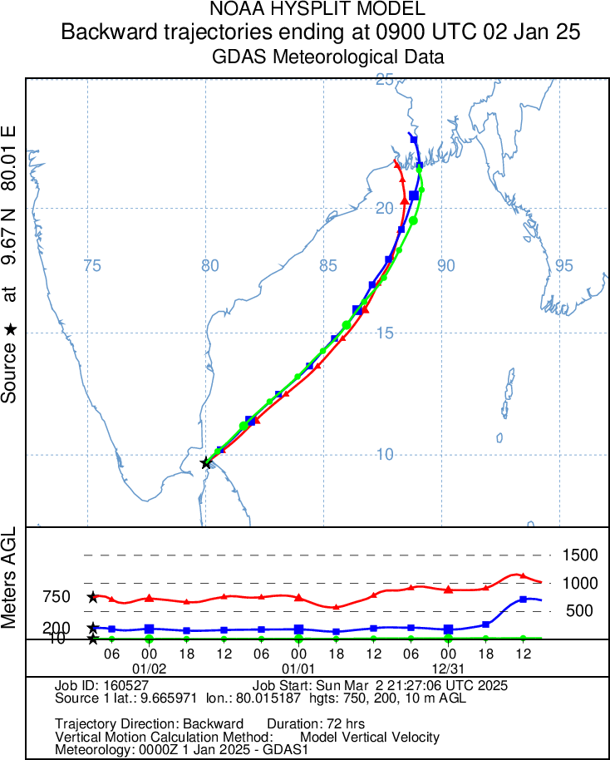
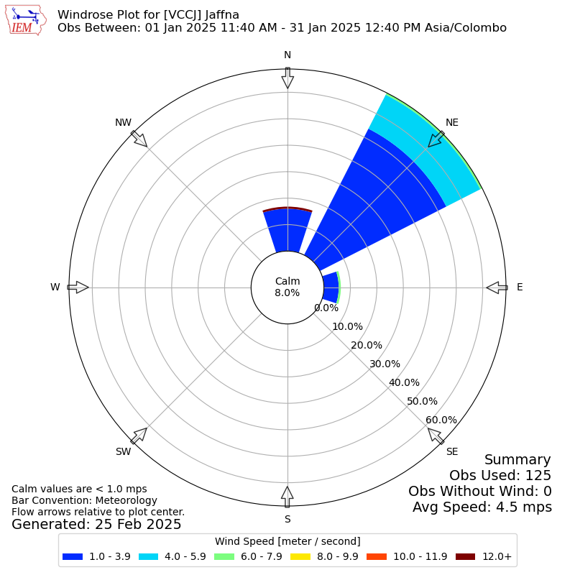
Weather / Wind During the Season where High Pollution Episodes Occur
Elevated pollutant levels are typically observed from October to March (mostly Nov-Dec-Jan-Feb), when winds flow from the NE (northeast). During other seasons, the predominant wind direction is SW (southwest).
Backward trajectory analysis and multiple air-quality models can be used to get the approximate pathways of incoming air parcels.
Windrose. January 2025 (Courtesy: mesonet.agron.iastate.edu)
Backward Trajectory, Jan 02, 2025 (Courtesy: NOAA HYSPLIT)

Slide 13
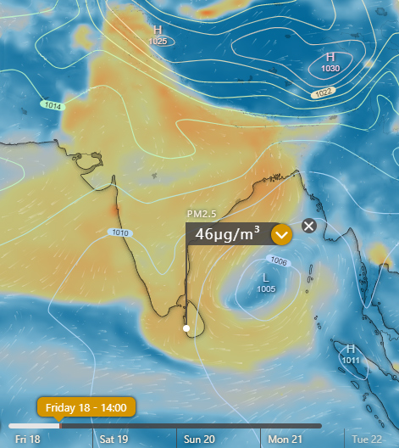
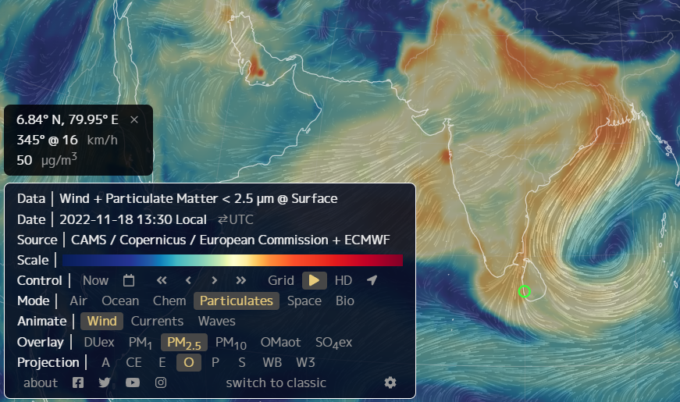
Seasonal Air Quality Pattern in Air Quality Earth Models
Regional (Around Sri Lanka) PM_{2.5} Distribution seen in two different Air Quality Models. Date: 2022-11-18
NullSchool Earth
Windy Earth

Slide 14
Transboundary Air Pollution
Key Considerations When Discussing Transboundary Air Pollution
🌏 Air pollutants come from both human and natural causes • Industrial, agriculture, domestic, natural dust, and wild fires. etc.
🌬️ Weather, climate, and seasonal winds play a major role • Wind direction/speed, temperature, and mixing heights strongly influence transport.
🎯 Source identification and contribution estimation are difficult • Hard to find the origin/source, very hard to find the contribution percentage of it.
🙌 No entity intentionally emits pollutants • Emissions arise from development needs and daily living conditions, and natural causes.
⚖️ Practical priorities differ across populations • Basic needs and livelihoods may take precedence over cleaner options.
⚠️ The most vulnerable groups are affected the most • Sub-regions with the highest pollution levels need support the most.
🌐 Transboundary pollution is best addressed collaboratively • Joint discussions, shared data, shared ideas, shared solutions, and technical cooperation helps.

Slide 15



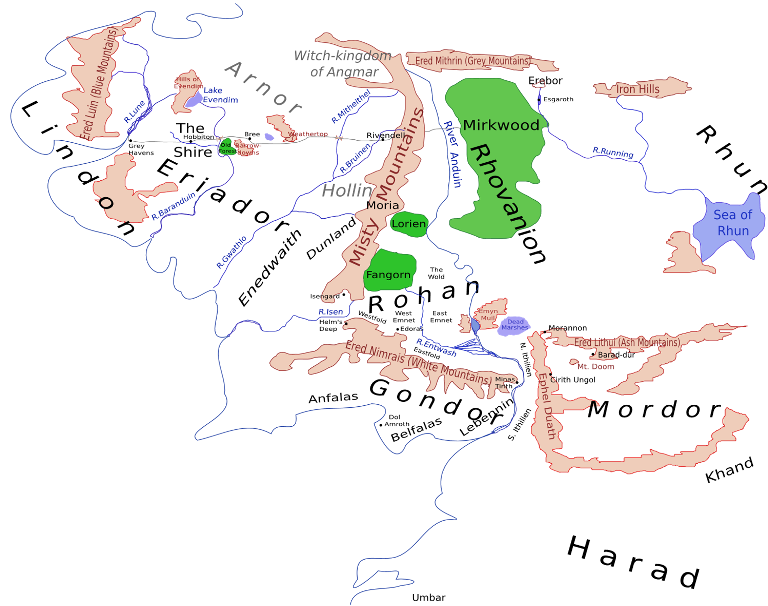

Transboundary Air Pollution: A Hypothetical Scenario
Z may initially think Y is the source.
But more data could show that X is the origin.
Further investigation might also reveal W as a contributor.
Yet the level of contribution of each, or all the root causes may remain unknown!
W
X
Y
Z
A Map of Middle Earth (LotR). Source: Wikipedia

Slide 16
Specific Support Required from Regional and Multilateral Partners
Collaborative Pollution Control
Regional Monitoring Network
Collaborative regional pollution control strategy development.
Strengthened monitoring network across the region.
Shared Model
Capacity Development
Shared regional air quality modelling and forecasting system.
Focus on capacity development and knowledge exchange.

Slide 17

Shared Regional Air Quality Modelling and Forecasting System
Unified Collaborative Regional Monitoring Data Hub
Shared Regional Modeling & Forecasting Hub
Shared Regional Infrastructure for Advanced Analytics & Decision Support
If possible, merging existing initiatives to establish a single, comprehensive, and fully operational regional air-quality management system, with shared infrastructure, predictive modelling, and coordinated policy enforcement, would be ideal. If such full consolidation is not feasible or practicable, then a collaborative regional air-quality modelling and forecasting framework, supported by active stakeholder engagement, would still offer significant regional benefits.

Slide 18
Collaborative Regional Pollution Control Strategy Development
🌀🔍🤝 Integrated Problem Cycle
Joint approach to problem identification, cause analysis, solution design, and strategic mitigation.
🛠️💰⚡ Feasible Emission Control
Enables practical, cost-effective, and technically achievable emission reduction measures through shared successful solutions.
🌏📍🎯 Region-Specific Solutions
Supports solutions tailored to local conditions, economic realities, and regional characteristics, ensuring actions are realistic and region-friendly.
🔬📚🤝 Shared Research & Evidence Base
Facilitates coordinated studies, investigations, and observations across agencies, sectors, and countries to identify root causes and inform mitigation.

Slide 19
Collaborative Regional Pollution Control Strategy Development, cont.
📈⚖️🏗️ Balanced Development
Reduce emissions while minimizing negative impacts on economic growth, essential development activities, and regional priorities.
📊📑✔️ Evidence & Result-Based Decision-Making
Enables decisions supported by best-practice exchanges, integrated data, research outputs, and measurable results, improving effectiveness and accountability.
🔧📈💲 Low-cost + high-quality validation + innovation
Use, promote, introduce or innovate affordable devices, technologies, and methods, combined with novel calibration, correction, validation, and verification approaches (e.g. with machine-learning / AI), to deliver highly accurate and locally relevant data, even for very low cost.
🌬️🌐🔗 Tackling Local & Transboundary Pollution
Enhances collective capacity to identify causes, diagnose regional problems, and develop practical, economical, and feasible solutions through shared ideas, coordinated action, and strengthened collaboration.

Slide 20
PS. More Things!... Data Capturing, Presenting, Interpretation Concerns
,
A Common Standard, Practices or Guideline or Considerations :
Data Capturing Device/Technology (When doing temporal & special comparisons)
For PM: Gravimetric, Beta-Attenuation, Optical-Scattering, Particle-Counting ...
Pollution Control Cost vs Benefit Assessment (Accuracy, Public Awareness)
Convincing the public & governments. Long-term benefits, assessments with accurate information.
Averaging
Data Completeness/Availability
Averaging Methodology/Approach
Uncertainty
Composition (For PM)
Particle Type
Size Distribution

Slide 21
Closing Notes: Sri Lanka’s Contribution & Call to Action
Sri Lanka’s Contribution (Current & Potential)
🌐 Sharing air quality monitoring data
🔬 Participating in regional research
📣 Conducting awareness campaigns & regulatory revisions
📊 Supporting regional modeling
🤝 Attending collaborative workshops & technical exchanges
🎓 Capacity building / training programs
💡 Promoting clean energy adoption
Closing / Call to Action
🤝 Strengthen regional partnerships for shared data & interventions
🔬 Implement science-based, context-appropriate solutions
🌍 Recognize shared responsibility for cleaner air across borders
📈 Scale up indoor air quality initiatives
🧩 Foster multi-sector collaboration (government, industry, academia, civil society)
📡 Implementing advanced monitoring & early-warning system

Slide 22
Summary: What can be done?
,
Understanding Each Other's Capabilities & Needs
Get Something, Give Something
Give Something, Get Something!
Each other means public, private, commercial, non-commercial, etc. Any entity!

Slide 23

Let’s hope Everywhere, there will be Clean Air. Take care! Thank You!
Scan to Email
AQ@CEA.LK
Air Quality, Noise & Vibration Monitoring, Central Environmental Authority, Sri Lanka
CLEAN AIR WEEK 2025
or, just remember this email address :)

